Slide 1
Getting started with Tableau Software using Data file formats, connecting your Data to Tableau,creating basic charts(line, bar charts, Tree maps),Using the Show me panel
Shiva kumar
Section :- cse ( c)
Roll no:- 227r1a05j3
Course:- power bi

Slide 2

1.Download and Install Tableau:
First, you'll need to download and install Tableau Desktop or Tableau Public (a free version). Follow the installation instructions provided on the Tableau website for your specific operating system.

Slide 3
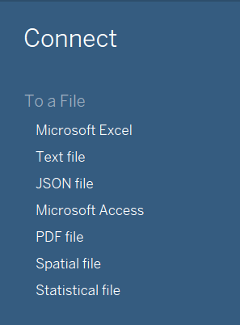
2. Prepare Your Data:
Before connecting your data to Tableau, it's important to ensure your data is in a format that Tableau can understand. Common supported data formats include Excel (.xlsx), CSV (.csv), and text files (.txt).

Slide 4
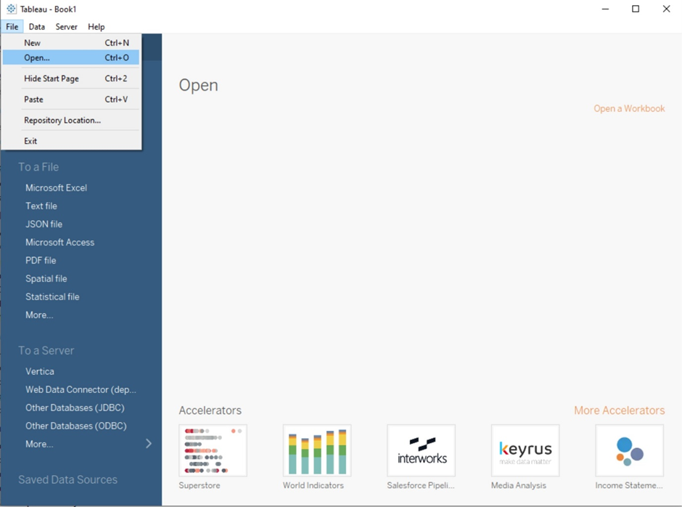
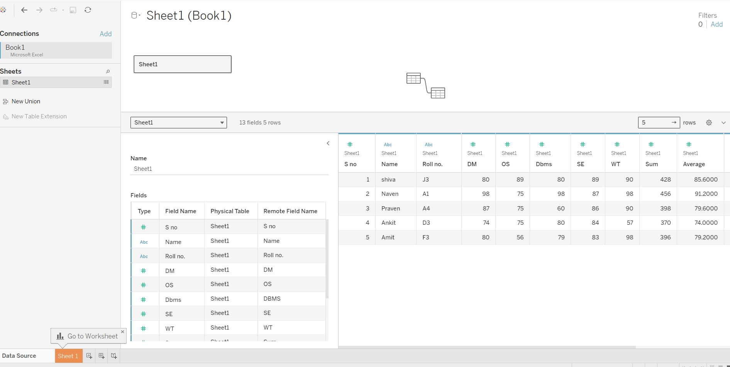
3. Connect Your Data to Tableau:
Steps to connect data:
Launch Tableau Desktop.
Go to "File" > "Open".
Choose the data source type and select the data file.
Drag the table (e.g., Orders) into the working area.
Click on the Worksheet tab (Sheet1).

Slide 5
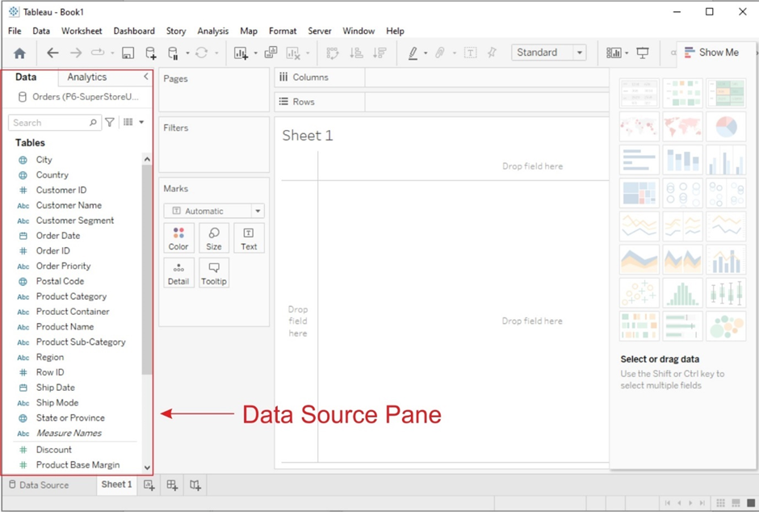
4. Data Source Pane:
Once your data is connected, the Data Source Pane will appear on the left-hand side of the Tableau interface. Here, you can see a preview of your data and perform data transformations or join multiple data sources if necessary.

Slide 6
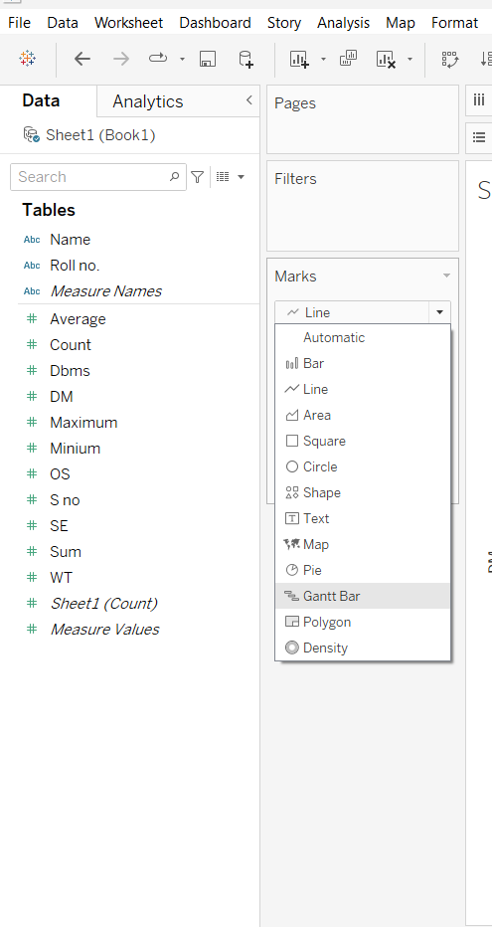
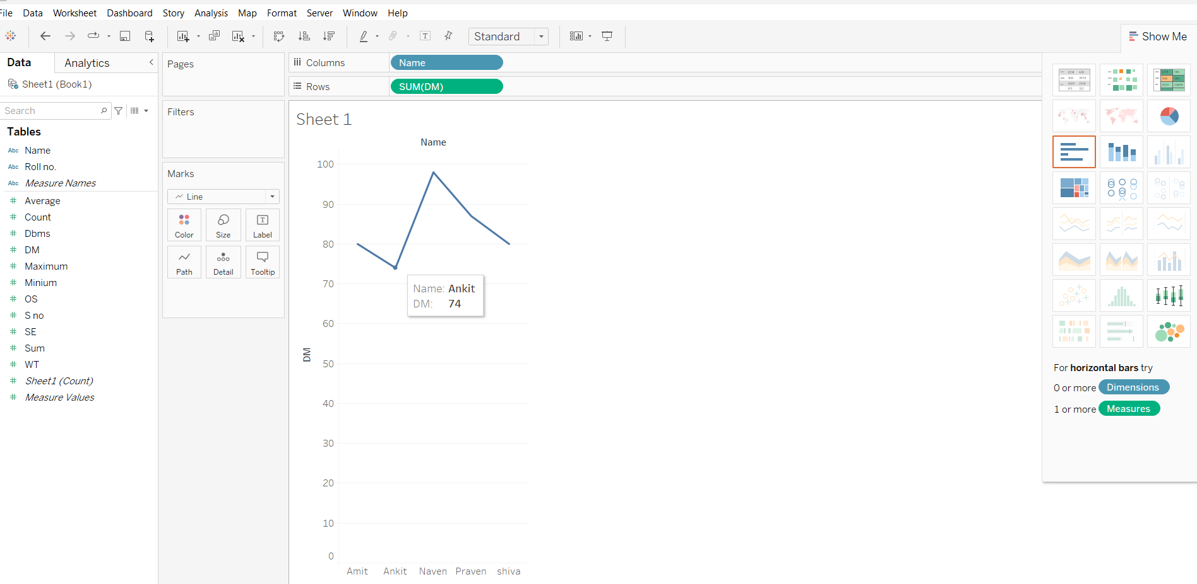
5. Creating Basic Charts:
a. Line Chart:
A line chart is a type of chart that displays information as a series of data points called 'markers' connected by straight line segments.

Slide 7
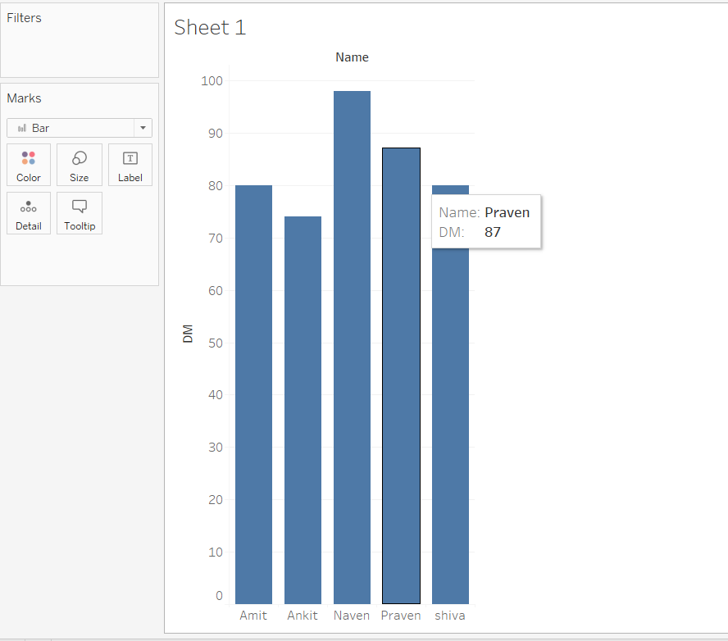
5. Creating Basic Charts:
b. Treemap Chart:
A treemap displays hierarchical (tree-structured) data as a set of nested rectangles. Each branch of the hierarchy is represented by a colored rectangle, with smaller rectangles inside representing sub-branches.

Slide 8
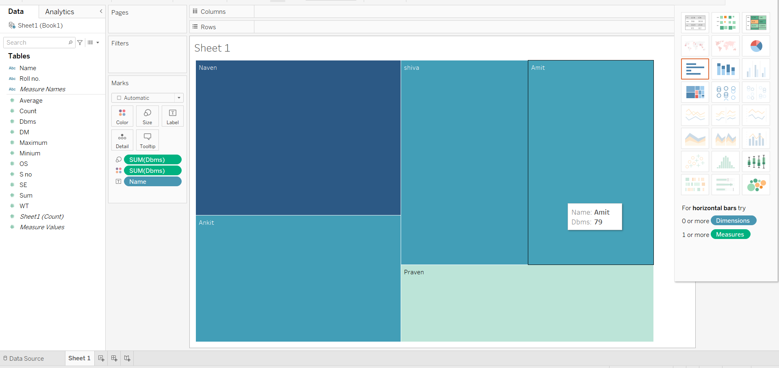
5. Creating Basic Charts:
b. Treemap Chart:
A treemap displays hierarchical (tree-structured) data as a set of nested rectangles. Each branch of the hierarchy is represented by a colored rectangle, with smaller rectangles inside representing sub-branches.

Slide 9
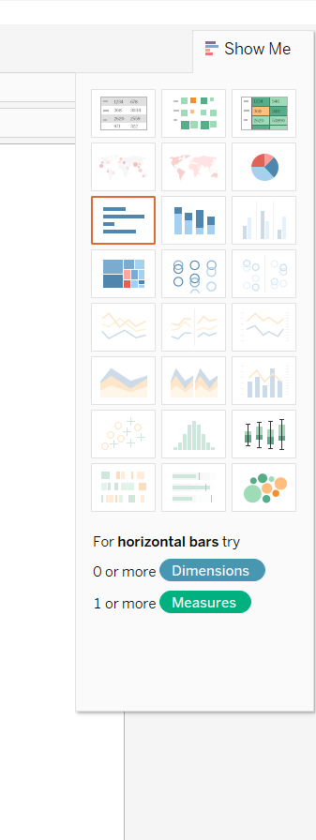
6. Using the Show Me Panel:

Slide 10


